Slide 1
Probability and Uncertainty in Neural Modeling
Anna Freund
Computational Neuroscience Unit, OIST

Slide 2
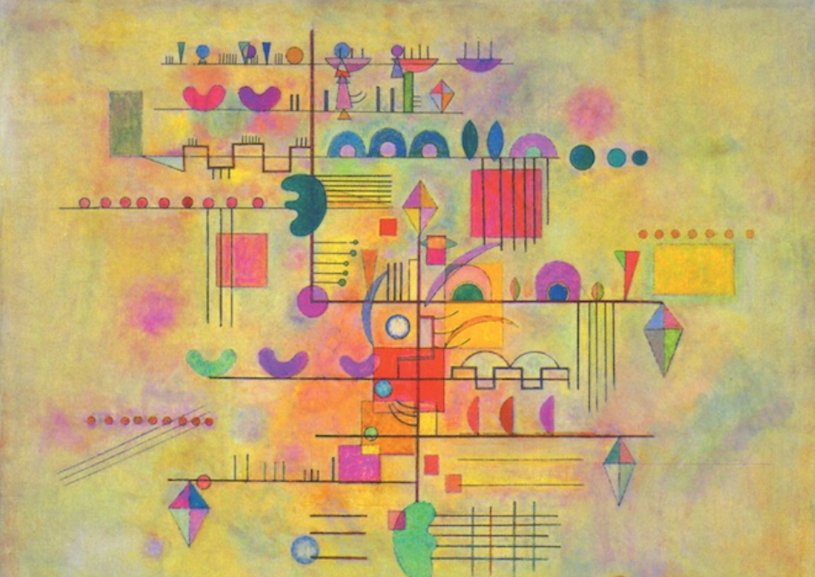
Contents
Why do we need probabilities
Basics of probability theory
Random variables
Probability distributions
Variability in spike trains
Poisson spike generator
Noise
Neural Data Analysis
Koch, Biophysics of Computation

Slide 3
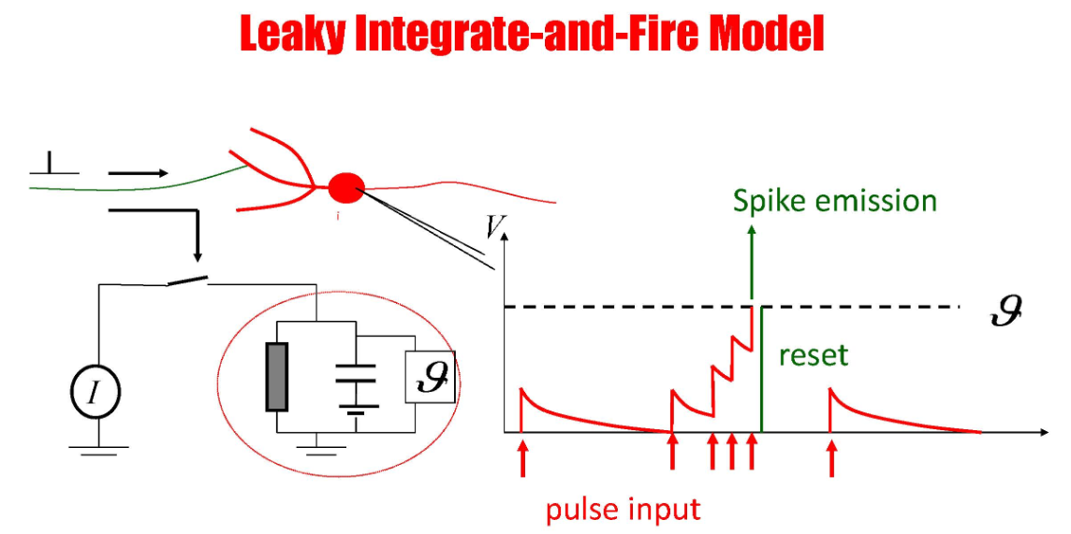
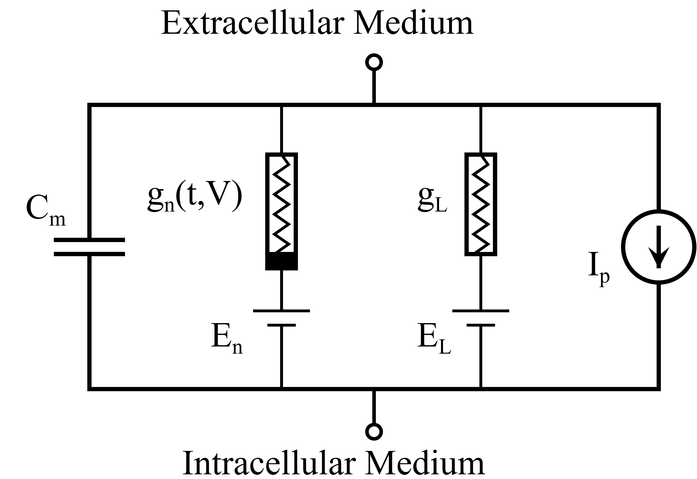
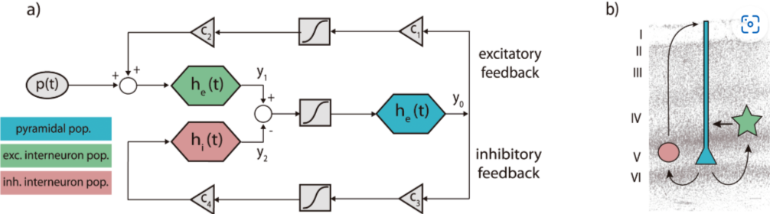
Why probability in neural modeling?
Notes:
You have seen several models in the last lectures. From single cell to neural systems. Describing activity as measured in biological experiments. So far this models were described by deterministic equations

Slide 4
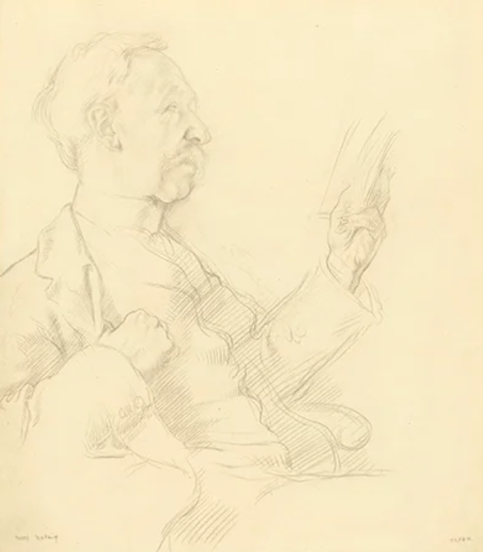
Deterministic model
Same input → Same output
Determinism is the metaphysical view that all events within the universe can occur only in one possible way
Britannica, 2026, https://www.britannica.com/topic/determinism

Slide 5
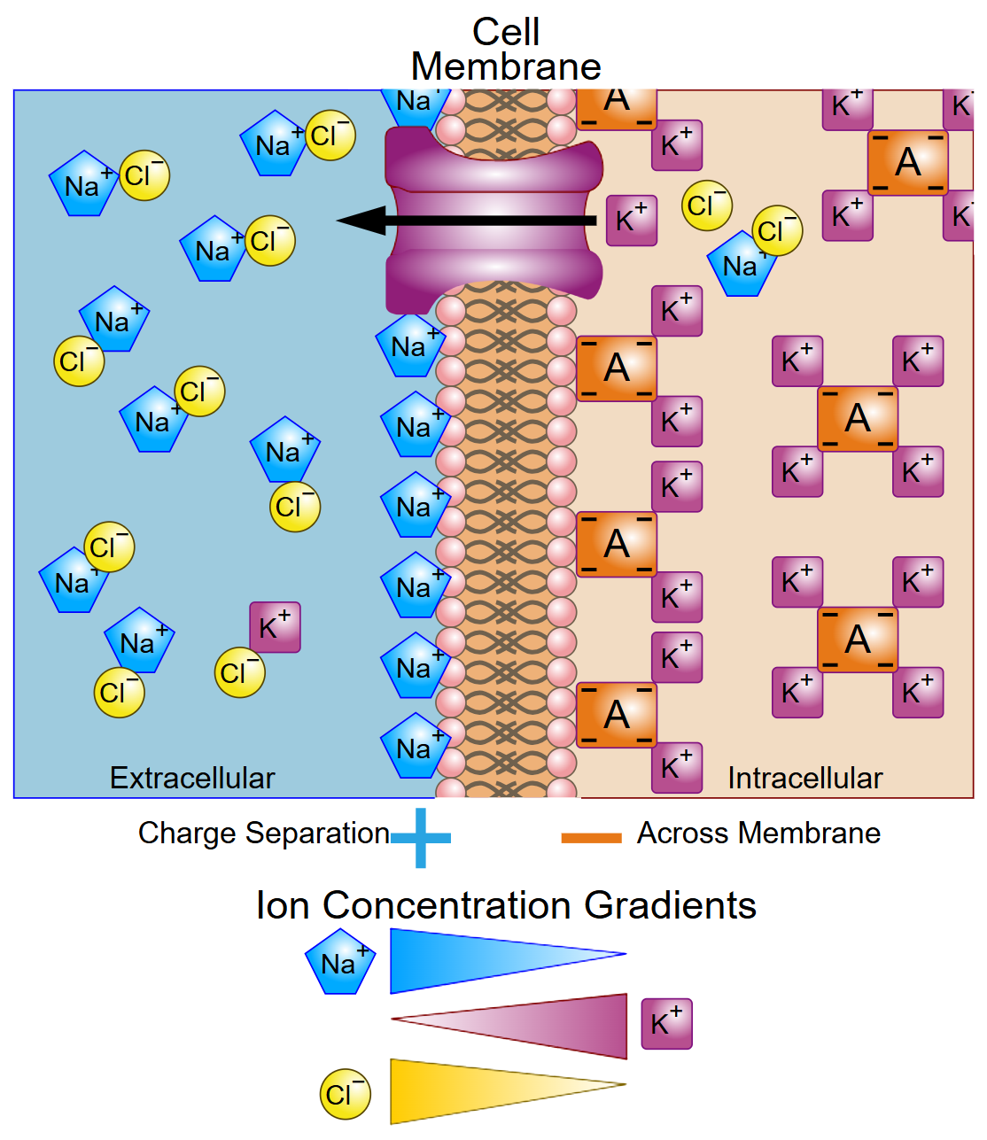
Why probability at all?
Scientists have established laws and equations to describe our surroundings
Laws of Thermodynamics
Newton`s Laws
Membrane potential of cells
Behavior of macroscopic systems, leaving out properties of single molecules
Wikipedia: Membrane potential
We need to include the stochasticity of single molecules to model variability
Wikipedia: Membrane potential, https://en.wikipedia.org/wiki/Membrane_potential
Notes:
For example the membrane potential of an neuron does not take into account the diffusion of each single ion, it is calculated from the concentration (sum of many ions)

Slide 6
Why probability in neural modeling?
Same input → output?
Single neurons and neural networks can be described with deterministic equations to model macroscopic events. Stochastic properties of single molecules are neglected.
But we can see the variability in our measurements
We want to understand and predict it
Notes:
Back to our question why we are interested in probability in neural modeling.

Slide 7
Variability in the brain
Same input → Variable output
Spike trains of individual neurons are irregular
If we would listen to measured electrical activity of a single neuron, we would only hear noise
Neurons exhibit spontaneous activity, not related to stimuli
High trial to trial variability in electrical recording with same stimulus
Synaptic transmission is determined by probabilities
Thermal energy: molecules move in along each dimension (kinetic energy)
We use probability to include variability and uncertainty
Notes:
What kind of variability do we see?

Slide 8
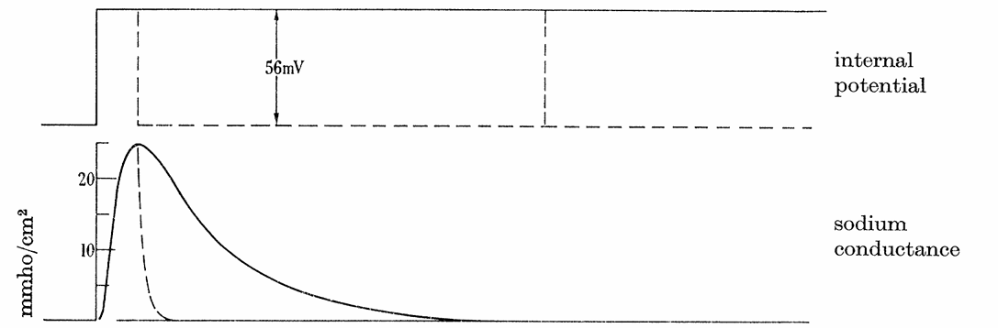
Stochastic openings of sodium channels
Hodgkin and Huxley described dynamics of membrane voltage in terms of deterministic ionic currents
Hodkin(1958), JSTOR, The Croonian Lecture: Ionic Movements and Electrical Activity in Giant Nerve Fibers
Koch, Biophysics of Computation
Notes:
Lets look at one example
Changes is sodium conductance after membrane depolarization. Voltage change → sodium current

Slide 9
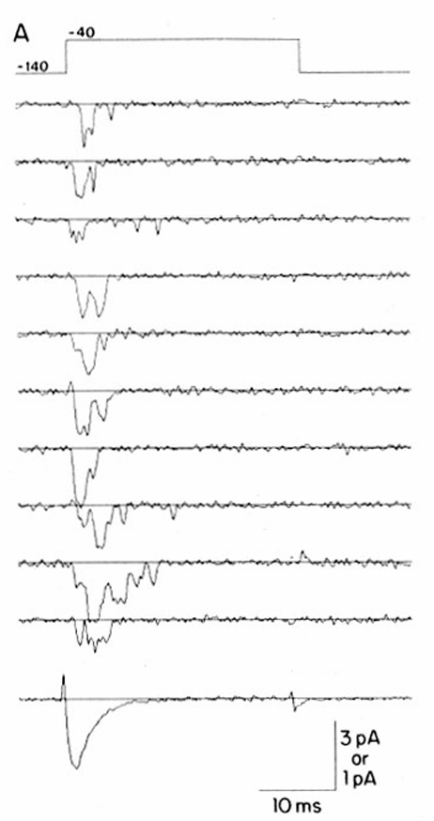
Stochastic openings of sodium channels
Patlak and Oriz recorded sodium channels from rat heart
Currents are caused by stochastic molecular pores
Macroscopic current is sum over microscopic currents of many channels
Hodkin(1958), JSTOR, The Croonian Lecture: Ionic Movements and Electrical Activity in Giant Nerve Fibers
Patlak and Oriz (1985), Journal of General Physiology, Slow Currents Though Single Sodium Channels of the Adult Rat Heart
Koch, Biophysics of Computation
Notes:
High trial to trial variability in sodium current with same stimulus
Average over 161 trails leads to smooth curve as described in deterministic equations

Slide 10
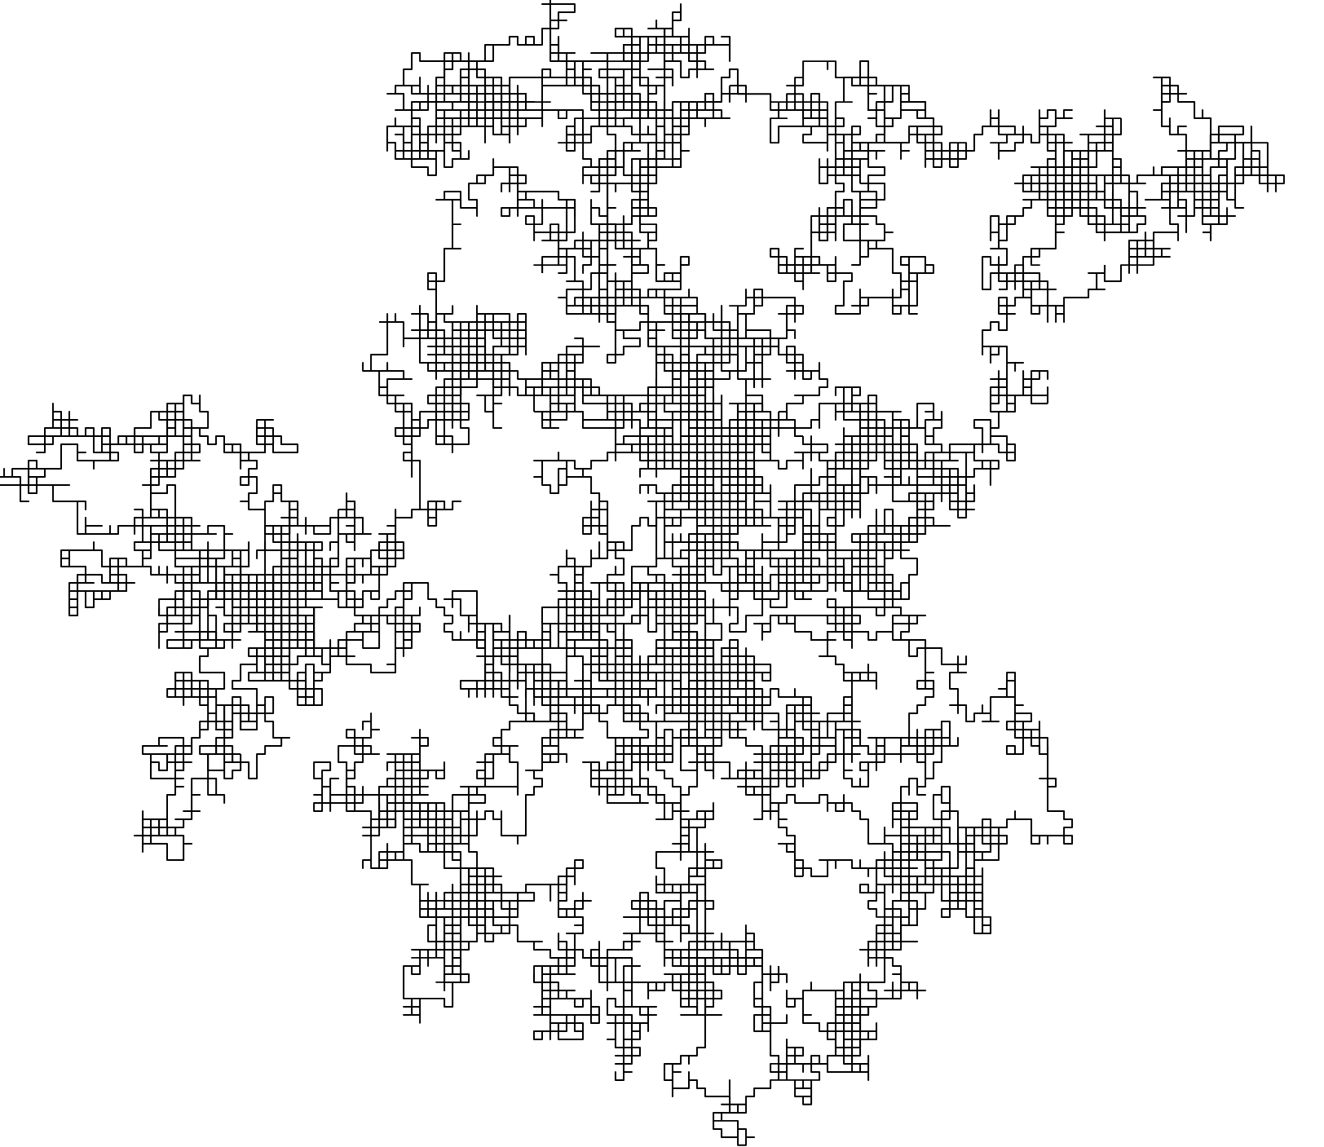
Thermal motion of molecules
Molecules have kinetic energy
Results in movement along each dimension
Direction of movement is described by a probability distribution
Random walk
Koch, Biophysics of Computation
Wikipedia: Random walk
Notes:
Where does the variability come from?

Slide 11
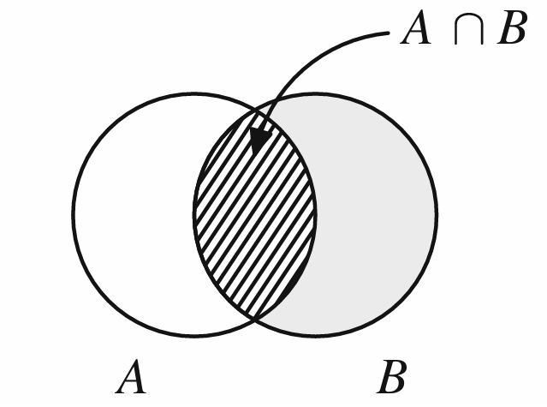
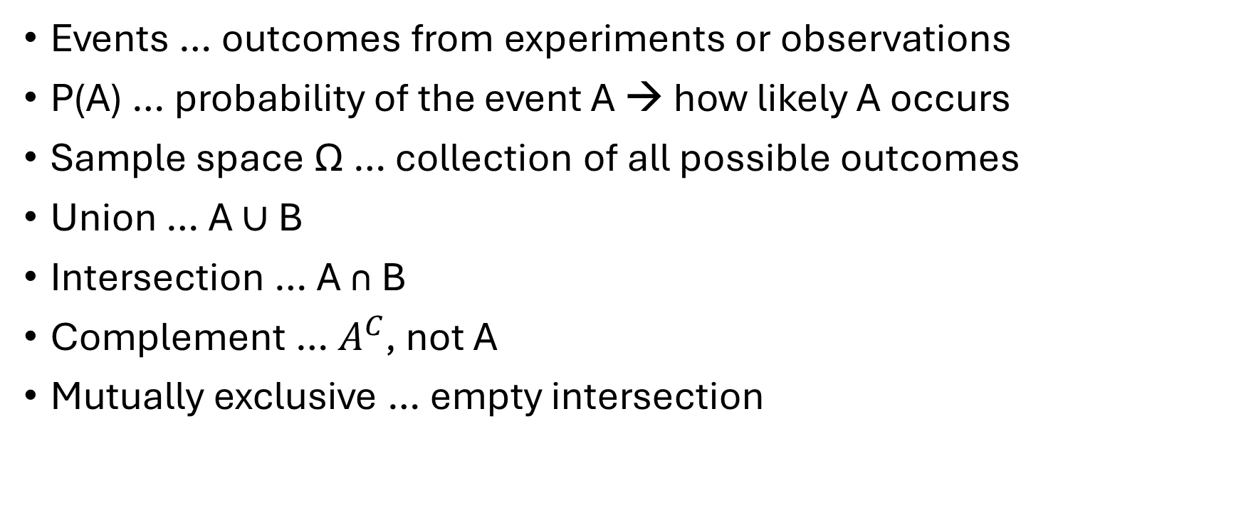
Probability
Events … outcomes from experiments or observations
P(A) … probability of the event A → how likely A occurs
Sample space Ω … collection of all possible outcomes
Union … A ∪ B
Intersection … A ∩ B
Complement … $A^{C}$, not A
Mutually exclusive … empty intersection
Kass, Eden and Brown, Analysis of Neural Data
Kass, Eden and Brown, Analysis of Neural Data
Notes:
First we need to understand some definitions and the basics of probability theory. So lets start with some definition

Slide 12

Axioms of Probability
For all events A, P(A) >= 0
P(Ω)=1
If $A_{1}$, $A_{2}$, …, $A_{n}$ are mutually exclusive events, then
P($A_{1}$∪$A_{2}$ ∪ … ∪ $A_{n}$) = P($A_{1}$)+ P($A_{2}$)+…+ P($A_{n}$)
Kass, Eden and Brown, Analysis of Neural Data
Kass, Eden and Brown, Analysis of Neural Data

Slide 13

Properties of Probability
P($A^{C}$)=1-P(A)
If A and B are mutually exclusive, P(A ∩ B)=0
P(A ∪ B)=P(A)+P(B)- P(A ∩ B)
Kass, Eden and Brown, Analysis of Neural Data
Kass, Eden and Brown, Analysis of Neural Data

Slide 14
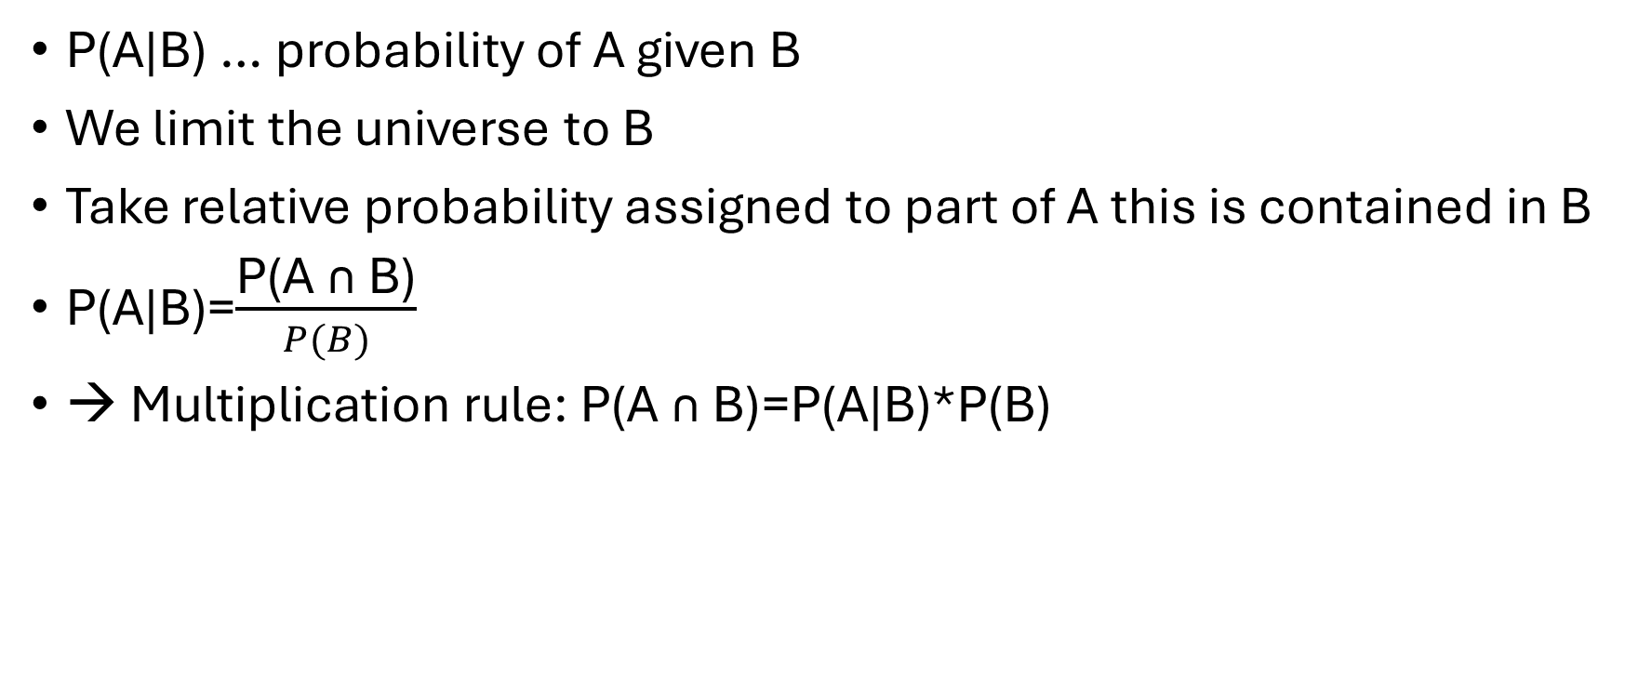
Conditional Probability
P(A|B) … probability of A given B
We limit the universe to B
Take relative probability assigned to part of A this is contained in B
P(A|B)=$\frac{\text{P(A ∩ B)}}{P(B)}$
→ Multiplication rule: $\text{P(A ∩ B)}$=P(A|B)*P(B)
Kass, Eden and Brown, Analysis of Neural Data
Kass, Eden and Brown, Analysis of Neural Data

Slide 15
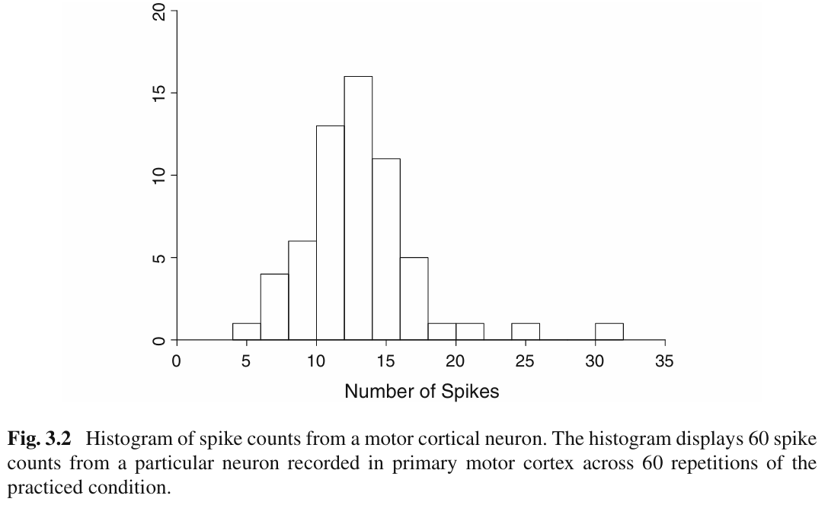
Random variables
Mathematical objects
Describe variation among quantitative measurements
Assign number to each outcome
E.g., spike count of each trial
Can be visualized by a histogram
Kass, Eden and Brown, Analysis of Neural Data
Kass, Eden and Brown, Analysis of Neural Data

Slide 16
Spike count from a motor cortical neuron
To study cortical correlates of practicing a movement
Recorded from primary motor cortex
Button-pressing task
Spike counts from single neuron
60 repetitions of same condition
Shows considerable variation
Uncertainty in random variable
(spike count) is described by
its probability distribution
Kass, Eden and Brown, Analysis of Neural Data
Kass, Eden and Brown, Analysis of Neural Data

Slide 17
Random variables
Described by distributions
f(x)=P(X=x) … probability mass function or probability density function (continuous random variable)
F(X)=P(X<=x) … cumulative distribution function
Means and variances of the random variables can be computed from the distribution
Kass, Eden and Brown, Analysis of Neural Data

Slide 18
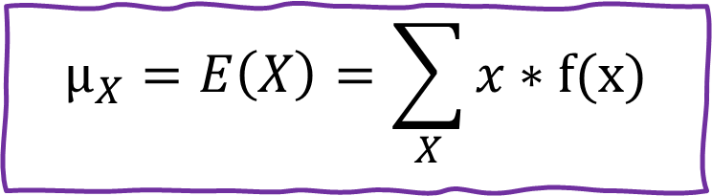
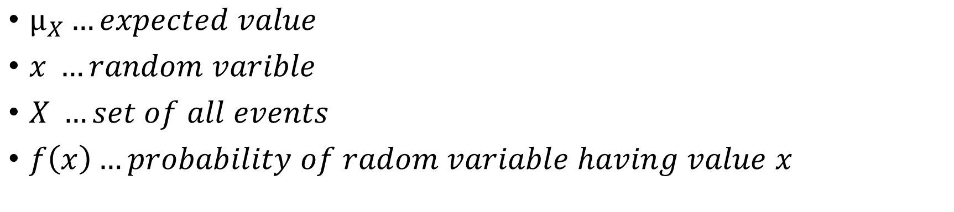
Expectation (mean) of random variable x
$$μ_{X}=E\left(X\right)=\sum_{X}{x}∗f(x)$$
$μ_{X}…expected value$
$x …random varible$
$X …set of all events$
$f\left(x\right)…probability of radom variable having value x$
Kass, Eden and Brown, Analysis of Neural Data

Slide 19
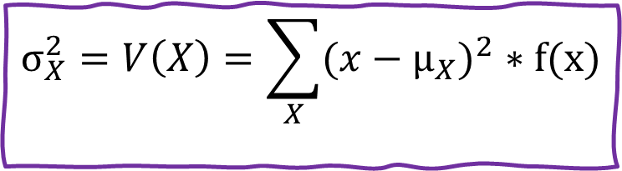
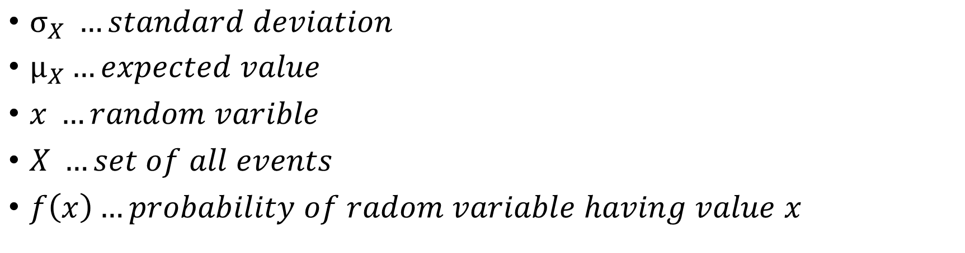
Variance of random variable x
$$σ_{X}^{2}=V\left(X\right)=\sum_{X}{{(x−μ_{X})}^{2}}∗f(x)$$
$σ_{X} …standard deviation$
$μ_{X}…expected value$
$x …random varible$
$X …set of all events$
$f\left(x\right)…probability of radom variable having value x$
Kass, Eden and Brown, Analysis of Neural Data

Slide 20
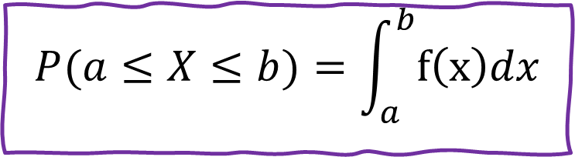
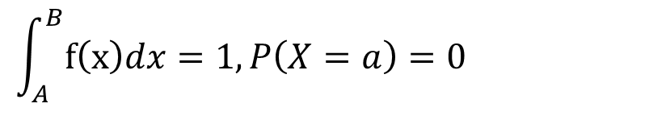
Discrete vs. continuous variables
So far, we talked about discrete random variables
Spike count could have values 0,1,2,…,35
For other measures like spike time interval, it would be more appropriate to consider all values within a defined interval
X … continuous random variable on interval (A,B), with A =−∞ and B =∞
$$P(a≤X≤b)=\int_{a}^{b}{f\left(x\right)dx}$$
$$\int_{A}^{B}{f\left(x\right)dx=1, P\left(X=a\right)=0 }$$
Kass, Eden and Brown, Analysis of Neural Data

Slide 21
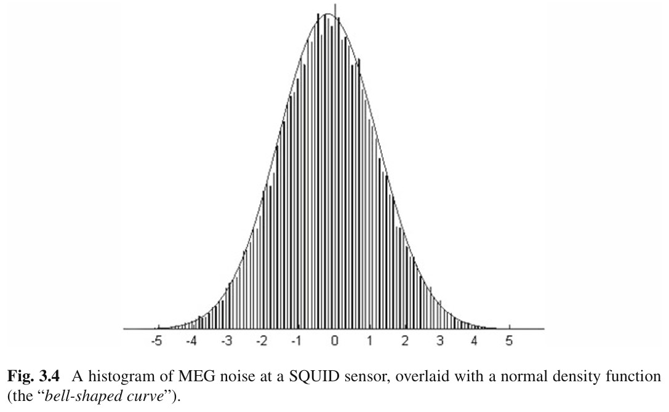
Probability distributions
Describe how probability is distributed over the possible values of a random variable
Different types of random variables
→ different types of distributions
Kass, Eden and Brown, Analysis of Neural Data
Kass, Eden and Brown, Analysis of Neural Data

Slide 22
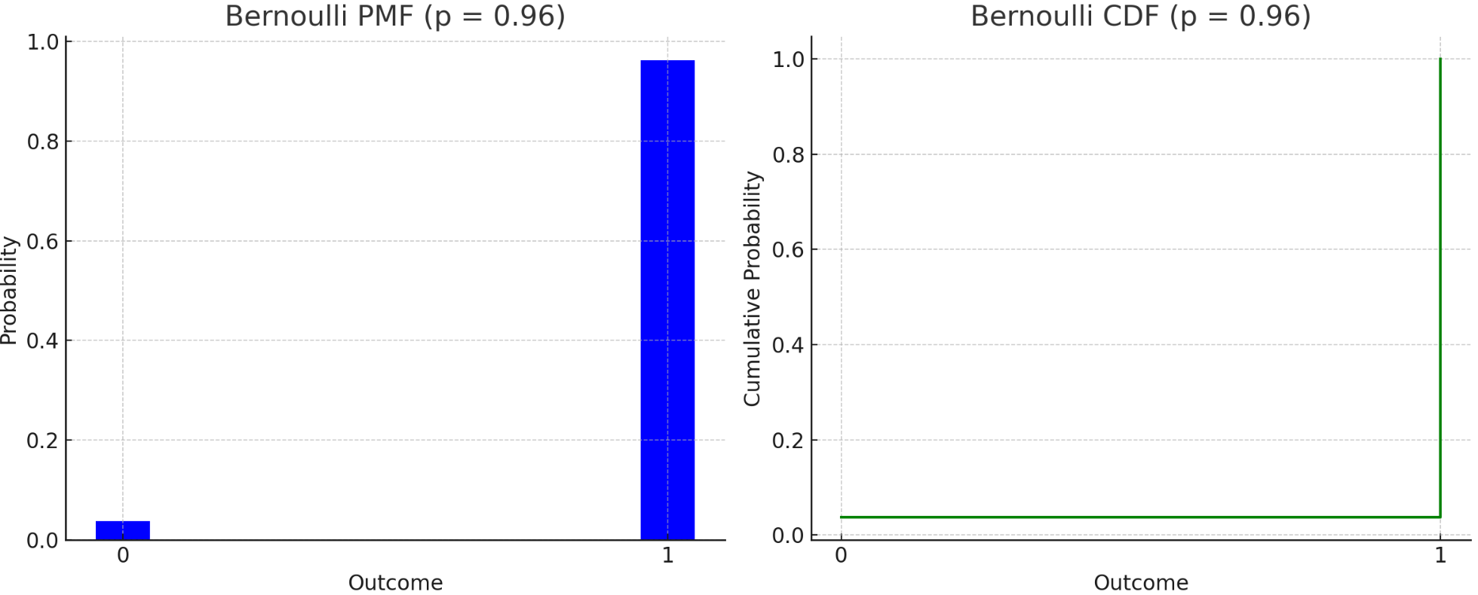
Bernoulli distribution
Random variables takes values 0 or 1
P(X=1) = p
P(X=0) = 1-p
E(X) = p
Var(X) = p*(1-p)
Wikipedia: Bernoulli distribution

Slide 23
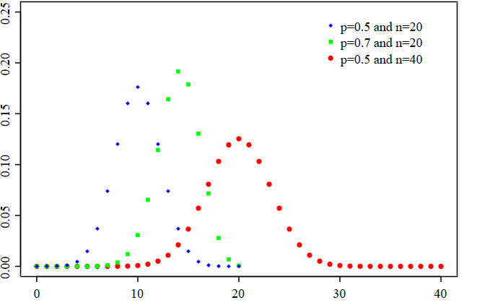
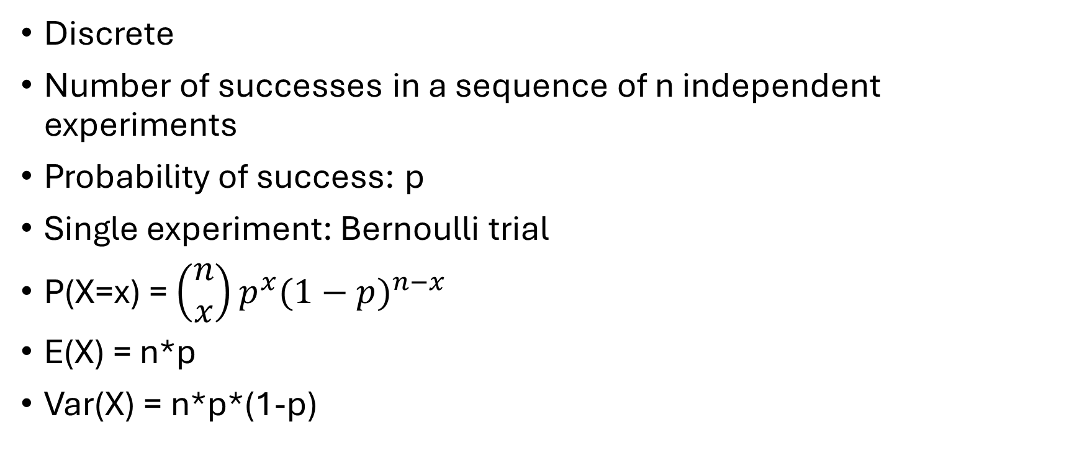
Binomial distribution
Discrete
Number of successes in a sequence of n independent experiments
Probability of success: p
Single experiment: Bernoulli trial
P(X=x) = $\left(\begin{matrix}n \\ x\end{matrix}\right)p^{x}{(1−p)}^{n−x}$
E(X) = n*p
Var(X) = n*p*(1-p)
Wikipedia: Binomial distribution
Notes:
If we repeat a Bernoulli experiment n times we get a binomial distribution

Slide 24
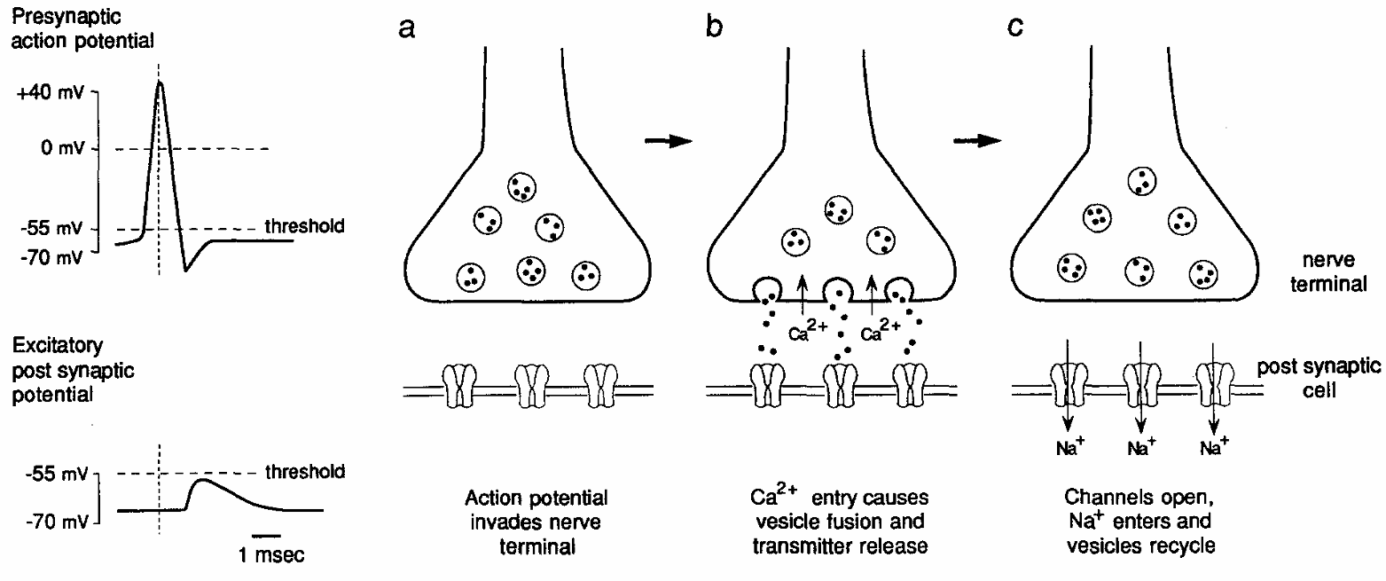
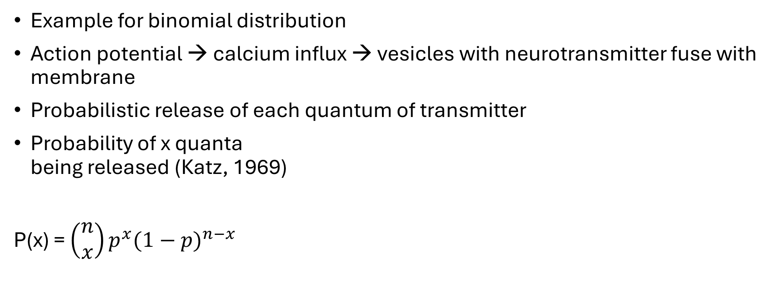
Quantal response in synaptic transmission
Example for binomial distribution
Action potential → calcium influx → vesicles with neurotransmitter fuse with membrane
Probabilistic release of each quantum of transmitter
Probability of x quanta
being released (Katz, 1969)
P(x) = $\left(\begin{matrix}n \\ x\end{matrix}\right)p^{x}{(1−p)}^{n−x}$
Jessel and Kandel (1993), Neuron, Synaptic Transmission: A bidirectional and self-modifiable form of cell-cell communication
Koch, Biophysics of Computation
Notes:
An example for a binomial distribution:
Quantal response is the release of package of neurotransmitter into the synaptic cleft

Slide 25
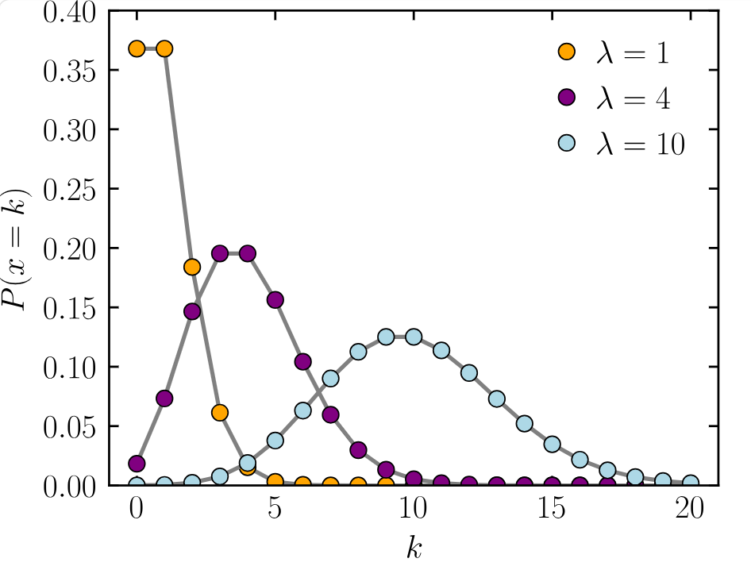
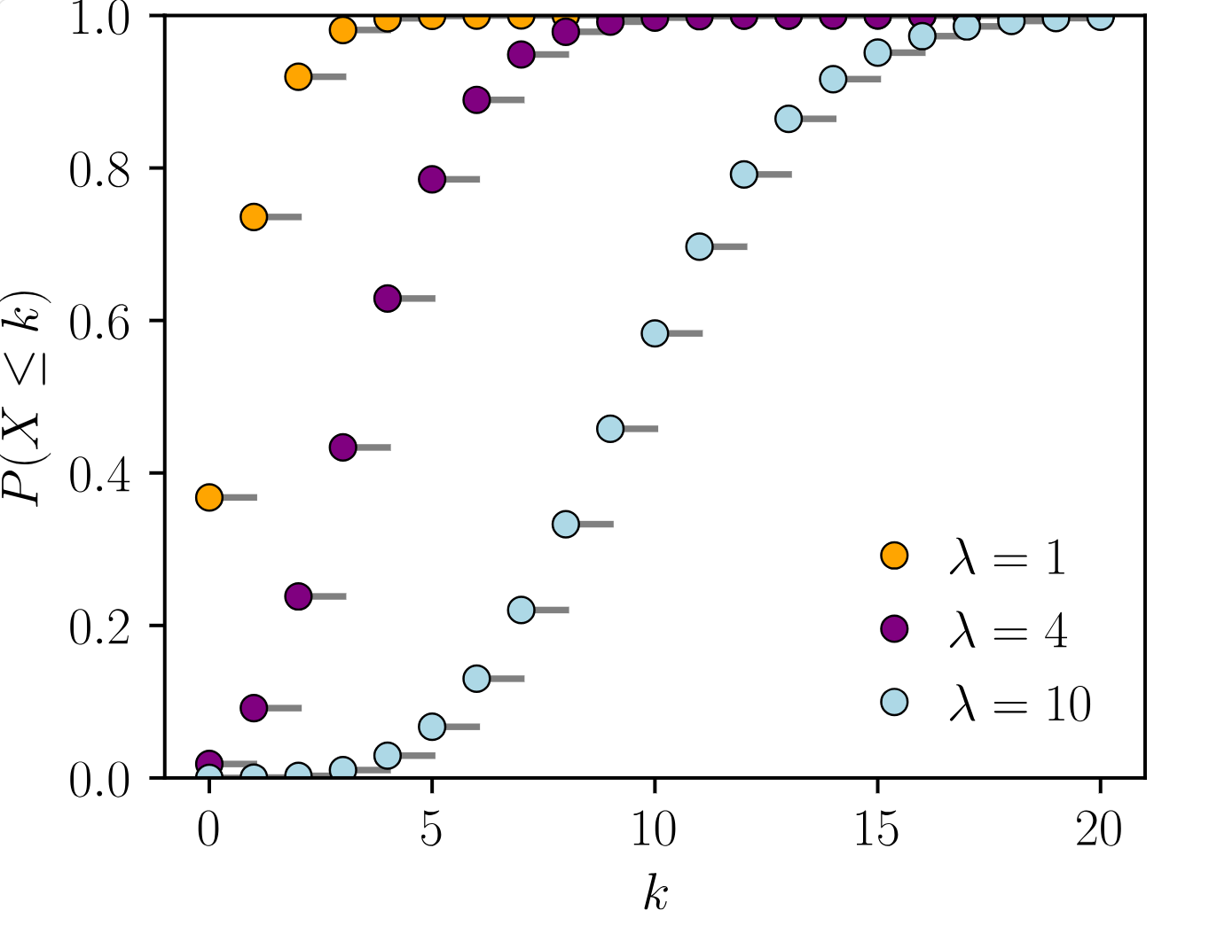

Poisson distribution
Used to describe counts of binary events
Assigns probability to every nonnegative integer
$P\left(X=x\right)=e^{−λ}\frac{λ^{x}}{x!}$
E(X) = λ
Var(X) = λ
Probability mass function
Cumulative distribution function
Wikipedia: Poisson distribution
Notes:
If there is an event that can happen or not, we want to know the probability of the event happening n times

Slide 26
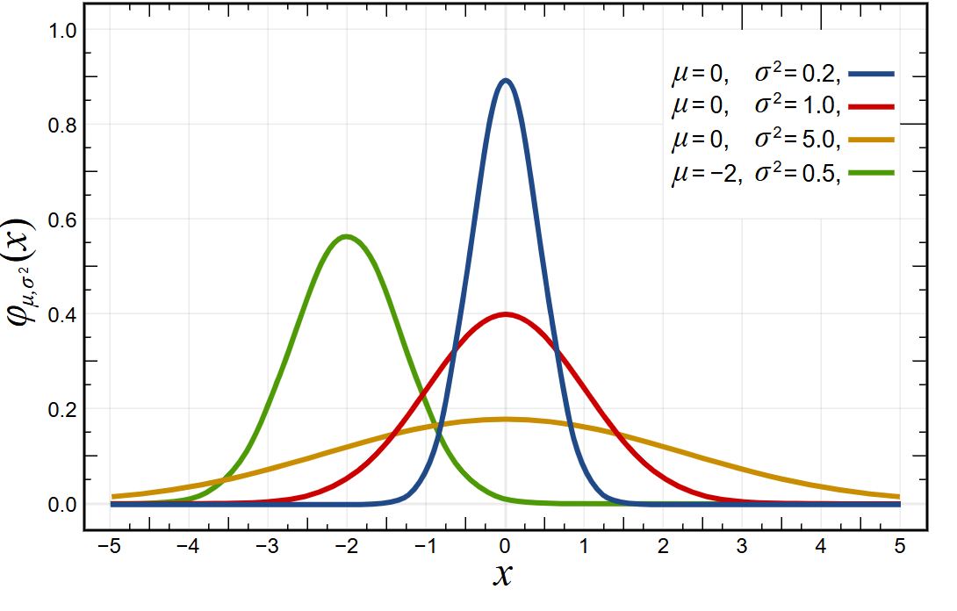
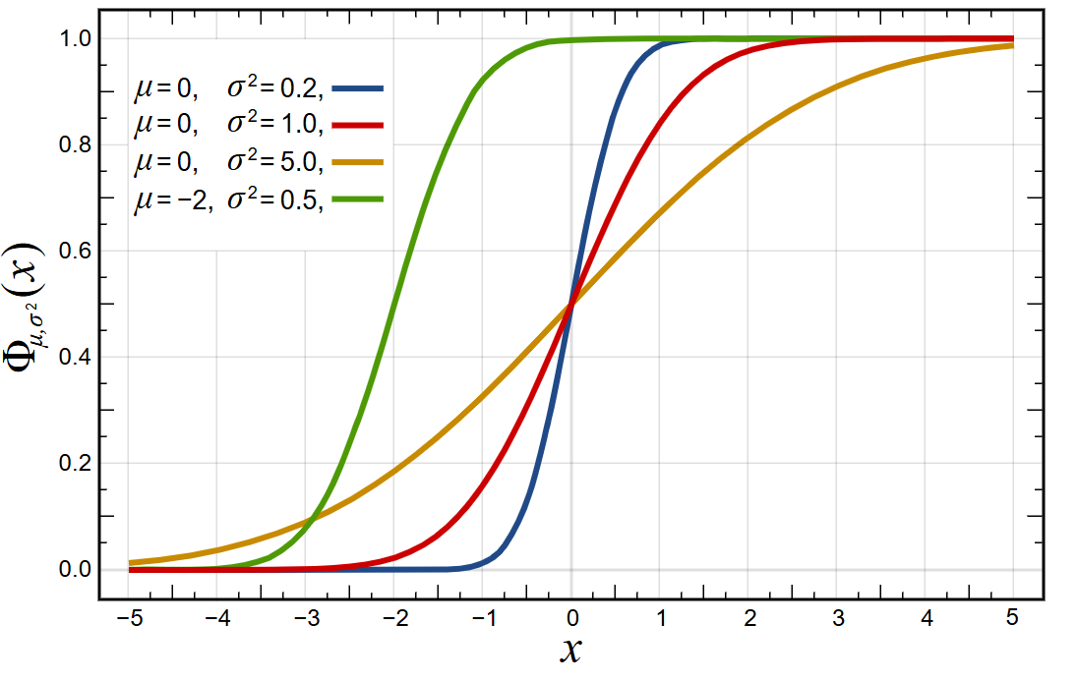

Normal distribution (Gaussian distribution)
$$f\left(x\right)=\frac{1}{\sqrt{2πσ^{2}}}exp⁡(−\frac{{\left(x−μ\right)}^{2}}{{2σ}^{2}})$$
Probability mass function
Cumulative distribution function
Wikipedia: Normal distribution
Notes:
Used to interpret standard errors and confidence intervals

Slide 27
Spike train
Discrete series of time events at which action potential is generated
Stochastic
Irregular discharge pattern of neuron
What property encodes information?
Mean rate code (firing frequency averaged over long time)
Intervals between spikes
Koch, Biophysics of Computation

Slide 28
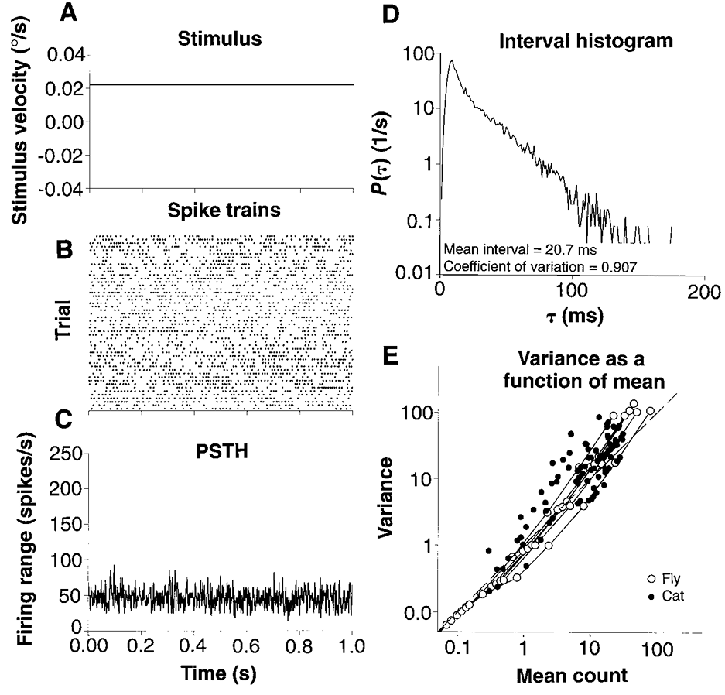
Spike train variability
Spike train of 50 trials
Spike rate (3 ms window)
Inter-spike interval (ISI)
Spike count
→ High variability
We need to work with probabilities
Ruyter et al. (1997), Science, Reproducibility and Variability in Neural Slike Tranis
Koch, Biophysics of Computation

Slide 29
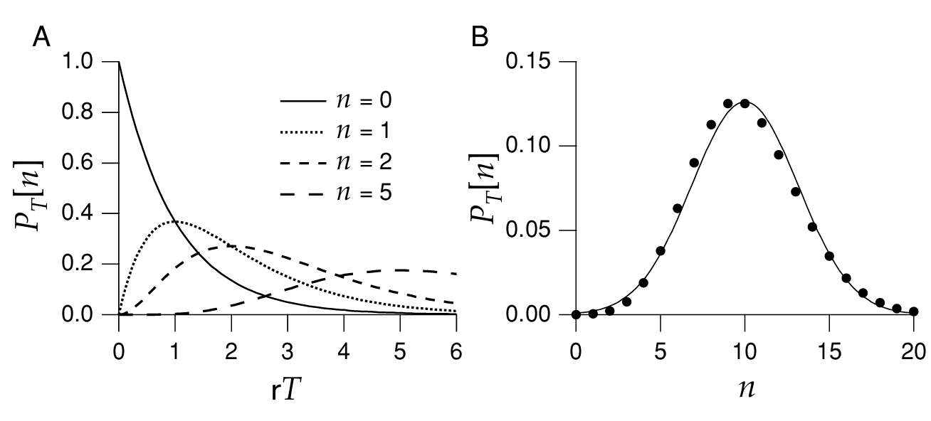
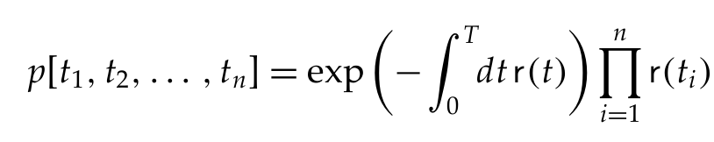
Poisson Process
Extremely useful to approximate stochastic neuronal firing
Describes a stochastic process that generates events
In our case: Spikes
Gives probability of a spike train of n spikes within a given time interval T and a time-dependent firing rate r
Dayan and Abbott, Theoretical Neuroscience
Dayan and Abbott, Theoretical Neuroscience

Slide 30
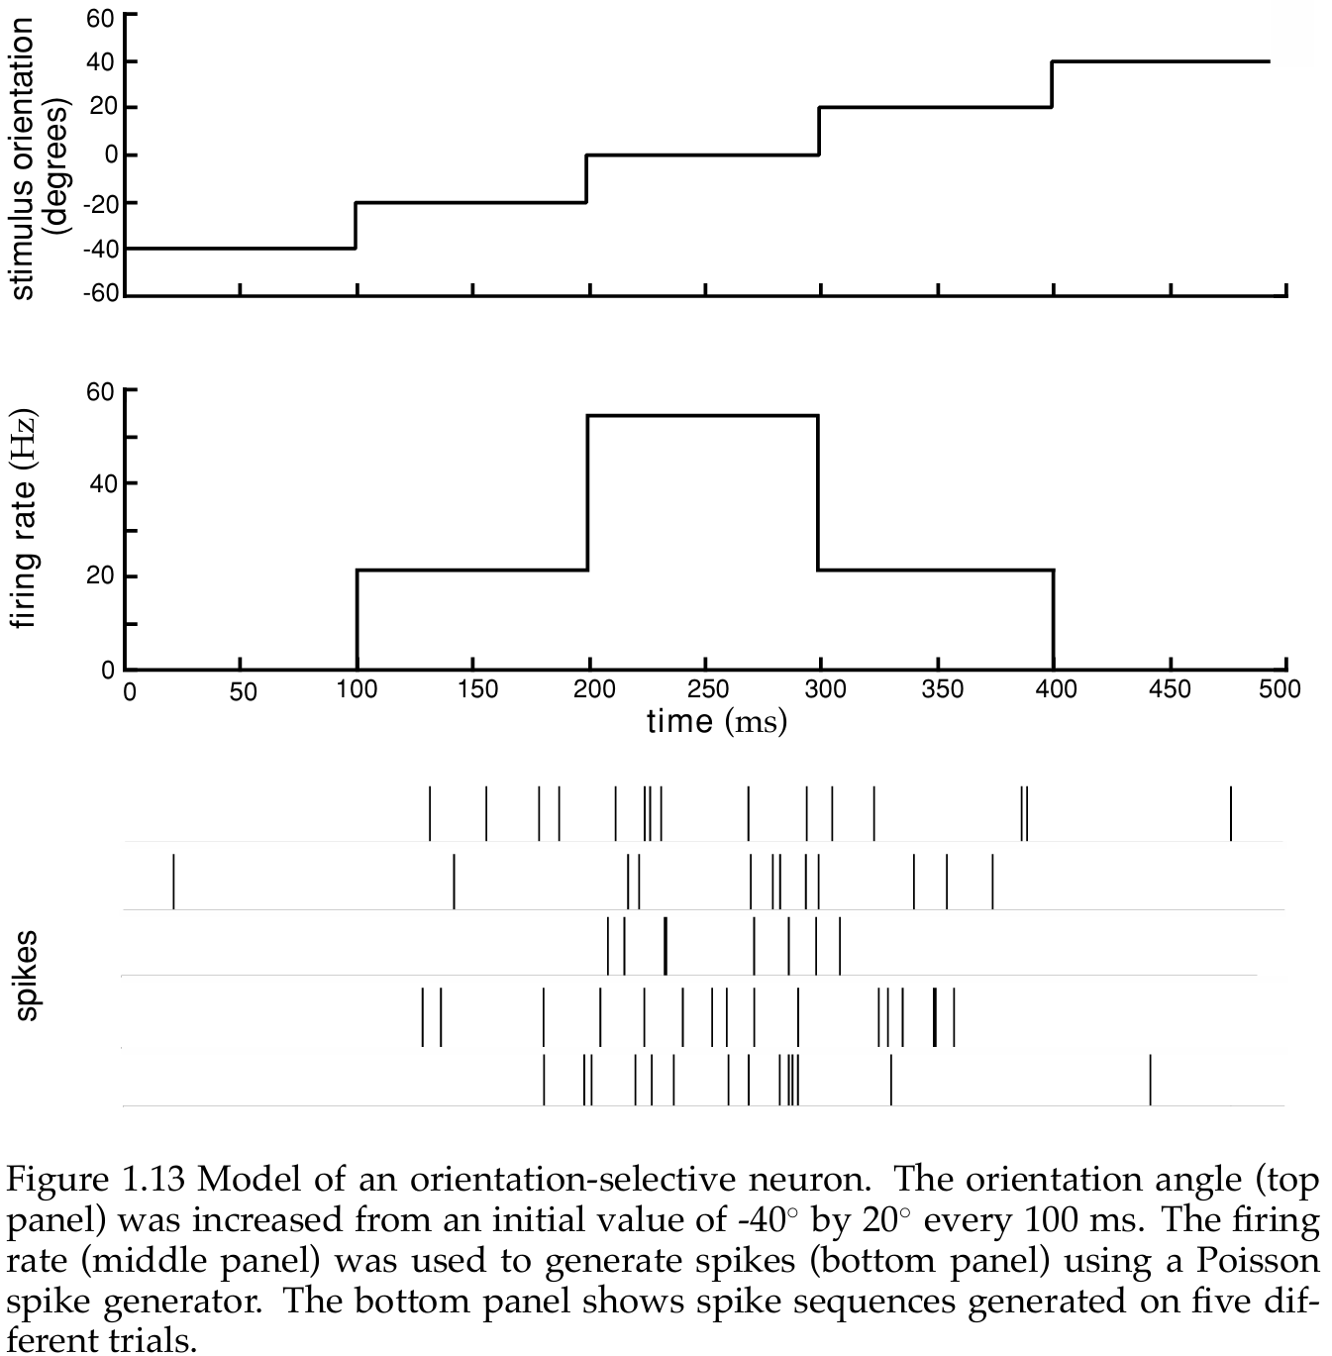
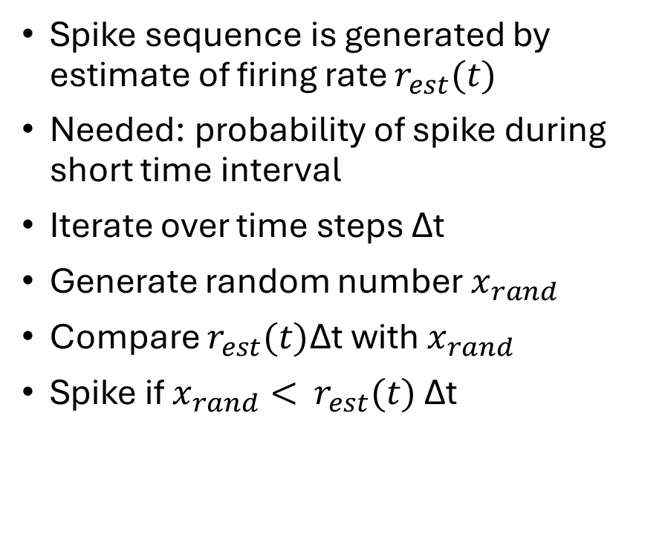
Poisson Spike Generator
Spike sequence is generated by estimate of firing rate $r_{est}(t)$
Needed: probability of spike during short time interval
Iterate over time steps Δt
Generate random number $x_{rand}$
Compare $r_{est}(t)$Δt with $x_{rand}$
Spike if $x_{rand}<$ $r_{est}(t)$ Δt
Dayan and Abbott, Theoretical Neuroscience
Dayan and Abbott, Theoretical Neuroscience

Slide 31
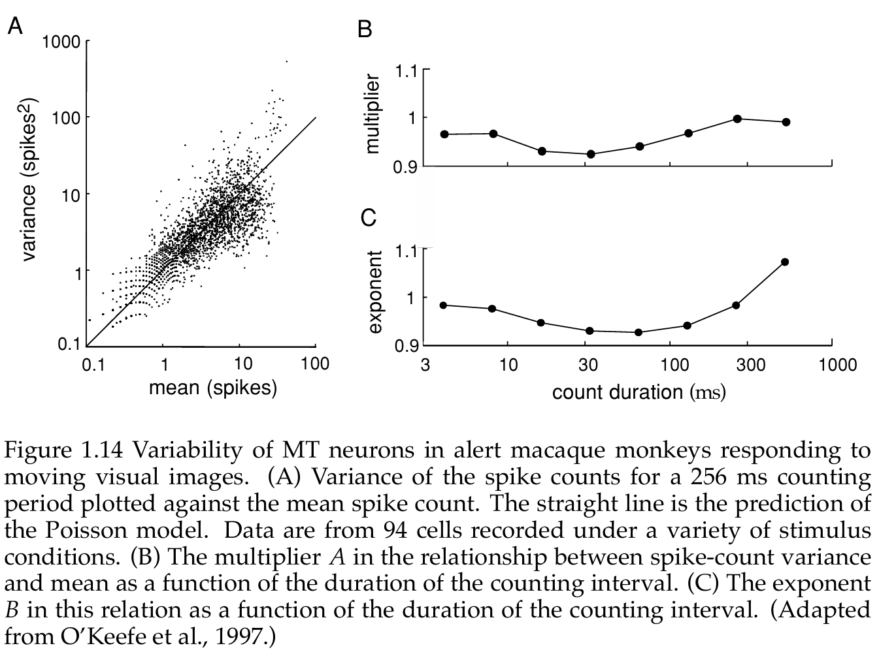
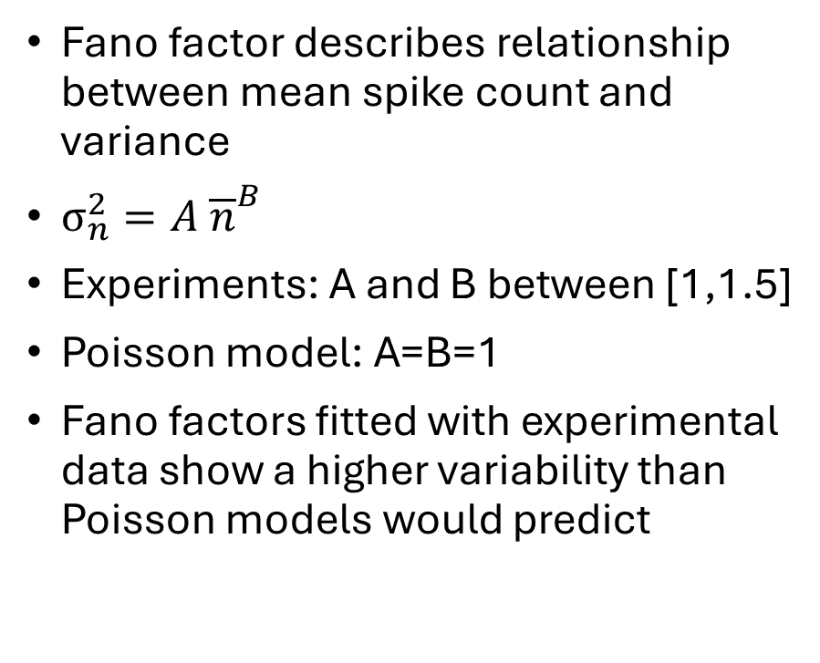
Spike Count
Fano factor describes relationship between mean spike count and variance
$σ_{n}^{2}=A {\overline{n}}^{B}$
Experiments: A and B between [1,1.5]
Poisson model: A=B=1
Fano factors fitted with experimental data show a higher variability than Poisson models would predict
Dayan and Abbott, Theoretical Neuroscience
Dayan and Abbott, Theoretical Neuroscience
Notes:
Good model, not perfect, refractory effects are often primary reason

Slide 32
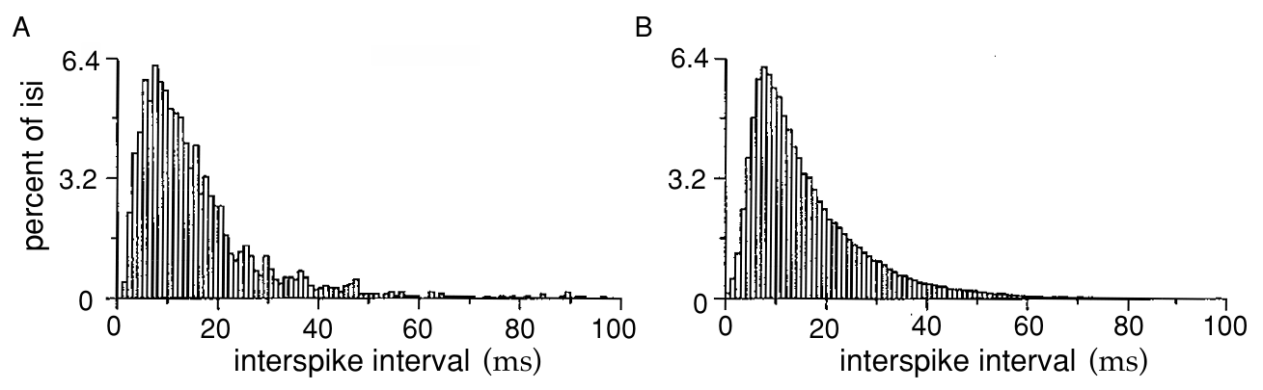
Interspike interval (ISI)
Neuron recorded from cortical area responding to a moving image
ISI calculated from spike train
Counting number of intervals falling in discrete time bins
Poisson model with stochastic refractory period
Neuron
Model
Dayan and Abbott (2001),Theoretical Neuroscience
Dayan and Abbott, Theoretical Neuroscience

Slide 33
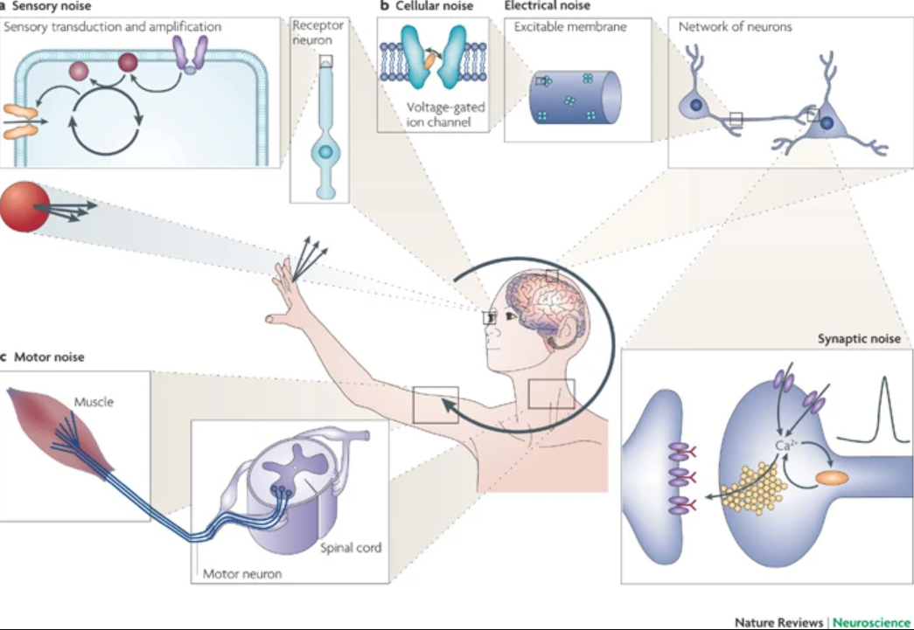
Noise
Thermal motion of molecules (“Intrinsic noise”)
Network noise
Measurement noise
Faisal et al. (2008), Noise in the nervous system

Slide 34
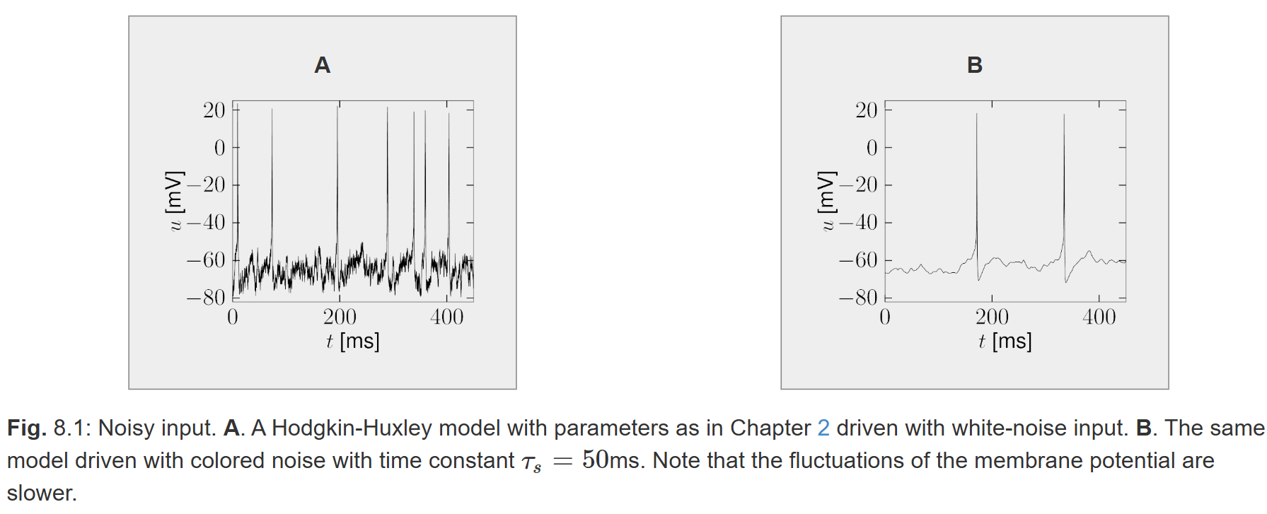
Network Noise
“Extrinsic noise”
Neurons receive input from thousands of other neurons
A lot of presynaptic spikes do not generate a postsynaptic response
High irregular spike trains
Can be modeled by adding
noise term to differential
equation
Gerstner et al., Neural Dynamics
Gerstner et al., Neural Dynamics

Slide 35
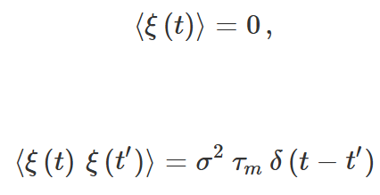

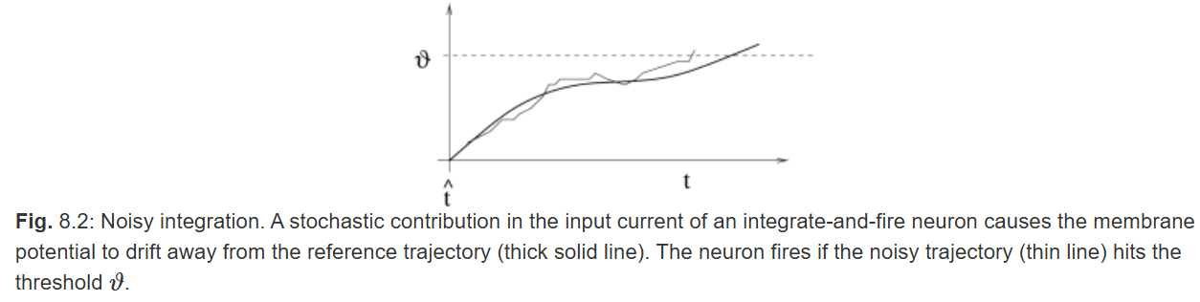
Network Noise
White noise
Stochastic process
Expected value is 0
Standard deviation is amplitude
Added to differential equation
Colored noise
Filtered white noise
Gerstner et al., Neural Dynamics
Gerstner et al., Neural Dynamics

Slide 36
Measurement Noise
Measurement artifacts also lead to trail to trial variability
Background noise
Biological Noise (EMG, EOG, EEG, …)
Powerline noise
Noise from technical equipment (amplifier, electrodes)
Filter
Repeat measurement and average over trails
Probabilistic modeling

Slide 37
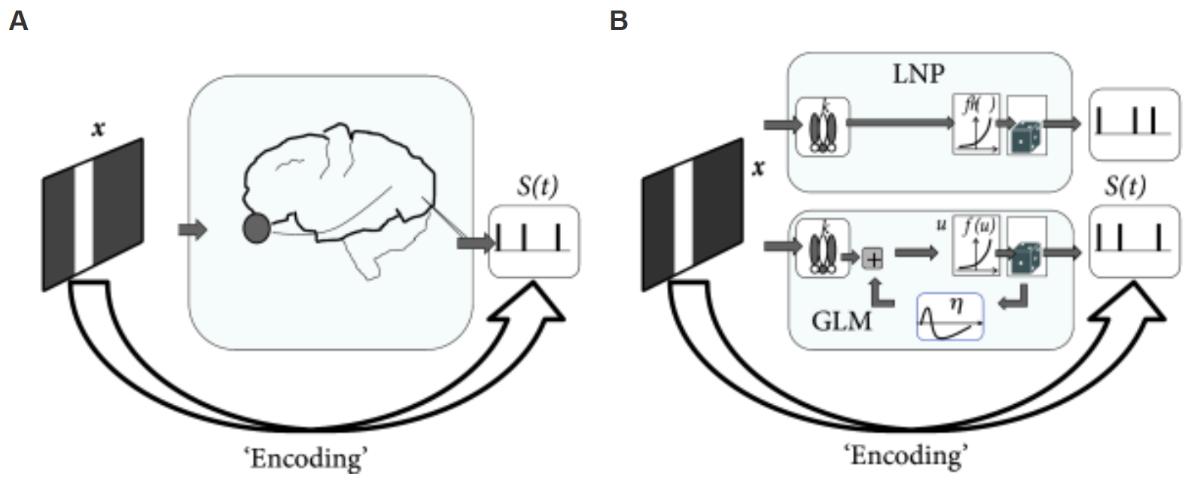
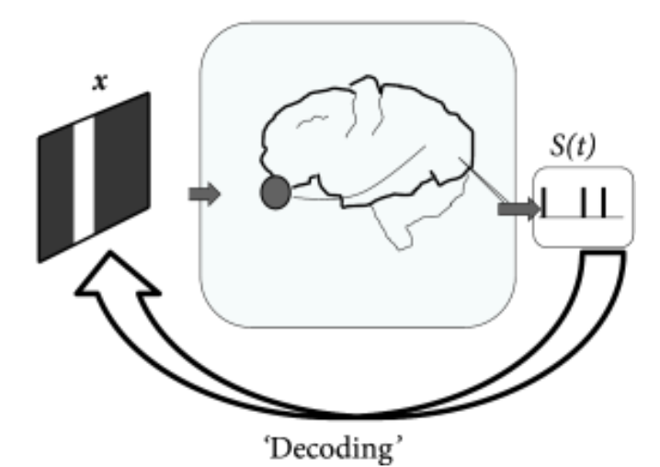
Neural data analysis
Encoding
How information is encoded in neural spike trains
Predict spike trains of a neuron
Given synaptic input, current injection, or sensory stimulus
Decoding
What can we learn from observation of spike sequence
Estimate stimulus that gave rise to spike train
Gerstner et al., Neural Dynamics
Gerstner et al., Neural Dynamics
Gerstner et al., Neural Dynamics

Slide 38
Model selection
Flexible and powerful enough to fit observed data
Tractable (possible to fit model with available data)
Respect underlying physiology and anatomy of system
Biophysical interpretability
Gerstner et al., Neural Dynamics

Slide 39
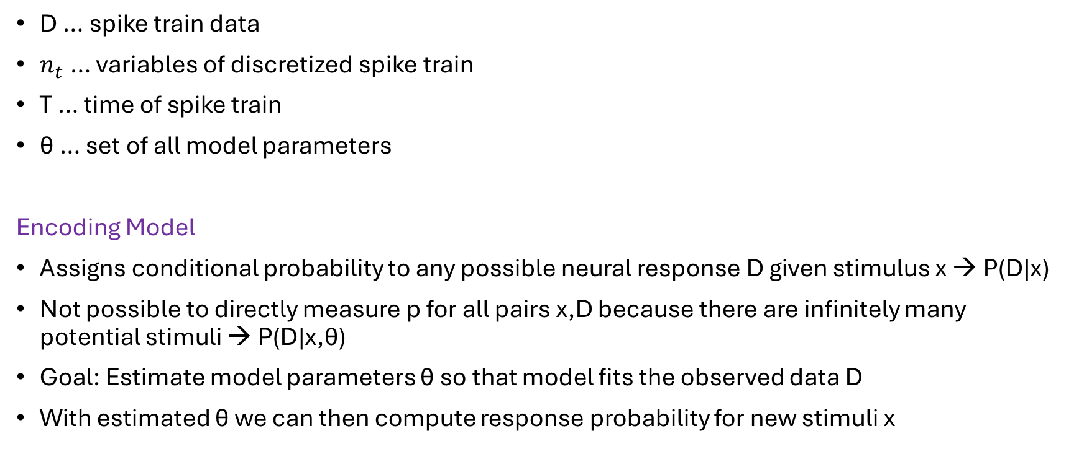
Statistical Formulation
D … spike train data
$n_{t}$ … variables of discretized spike train
T … time of spike train
θ … set of all model parameters
Encoding Model
Assigns conditional probability to any possible neural response D given stimulus x → P(D|x)
Not possible to directly measure p for all pairs x,D because there are infinitely many potential stimuli → P(D|x,θ)
Goal: Estimate model parameters θ so that model fits the observed data D
With estimated θ we can then compute response probability for new stimuli x
Gerstner et al., Neural Dynamics

Slide 40
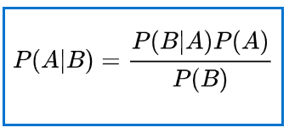
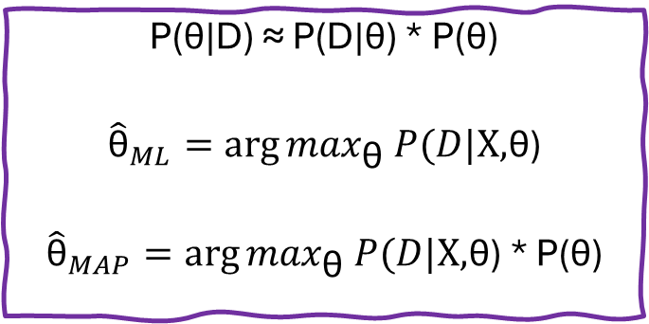
Parameter Estimation
Bayes` theorem
Compute posterior distribution of model parameters given observed data using Bayes` rule
Posterior: P(θ|D)
Likelihood: P(D|X, θ)
θ … model parameter
X … set of stimuli
Find θ that maximizes likelihood or posterior
P(θ|D) ≈ P(D|θ) * P(θ)
$${\hat{\text{θ}}}_{ML}=\arg{\max_{\text{θ}} P(D|\text{X,}\text{θ}\text{)}}$$
$${\hat{\text{θ}}}_{MAP}=\arg{\max_{\text{θ}} P(D|\text{X,}\text{θ}\text{)}\text{ ∗ P(}\text{θ}\text{)}}$$
Gerstner et al., Neural Dynamics
Notes:
We can use the MAP estimate if we have prior knowledge of our data

Slide 41

Likelihood P(D|X, θ)
Bayes` theorem
Gives us probability of observing the data D given stimulus X and parameter θ
We want to find the parameter θ, which gives us the highest probability of observing our data D
Maximize Likelihood function
P(θ|D) ≈ P(D|θ) * P(θ)
$${\hat{\text{θ}}}_{ML}=\arg{\max_{\text{θ}} P(D|\text{θ}\text{)}}$$
$${\hat{\text{θ}}}_{MAP}=\arg{\max_{\text{θ}} P(D|\text{θ}\text{)}\text{ ∗ P(}\text{θ}\text{)}}$$

Slide 42

Uncertainty
A probabilistic model predicts a distribution of possible responses, not necessarily one response
Use confidence intervals to give a range of plausible parameter values
Use mean squared error to estimate accuracy
Bias: Systematic error
Variance: High variability of estimate
Kass, Eden and Brown, Analysis of Neural Data
Kass, Eden and Brown, Analysis of Neural Data

Slide 43
To sum up
Probability gives us a tool to
Understand variability in neural systems
Simulate stochastic spike trains
Fit stochastic models
Evaluate estimated parameters and models
If you want to know more about …

Slide 44




… Computational Neuroscience

Slide 45
… single particles and thermal motion
Leonard Susskind: Lecture on “Statistical Mechanics” on YouTube
(not neuroscience related but very interesting to understand concept of thermal motion and where the “noise” comes from)

